Slide 1
Multiclass classification and price prediction of dry beans using Different Algorithms
STAT 602 Mid Term Project
Spring 2022
Prepared By
Md Mominul Islam (101009250)

Slide 2
PRJECT Outline
Background Study
Project Objective
Data Preview
Developed Algorithm
Exploratory Data Analysis
Statistical Model Development
Statistical Model Accuracy Summary
Project Conclusion
References

Slide 3
BACKGROUND STUDY
Dry bean cultivation is practiced in Turkey and Asian countries usually in the form of populations containing mixed species of seeds.
As different populations containing different genotypes are cultivated, the final products contain different species of seeds.
Finally, when the dry bean seeds obtained from population cultivation are released to the market without being separated by species, the market value decreases immensely. [2]
Because of the wide range of genetic diversity of dry bean, seed classification is essential for marketing and production.
To establish a sustainable agricultural system, Koklu et al. [1] provided method for obtaining uniform seed varieties from crop production.
To address the problem of market value, Koklu et al. [1] created distinct classification algorithms for seven different registered varieties of dry beans with comparable characteristics in order to achieve consistent seed categorization.
[1] Computers and Electronics in Agriculture 174 (2020): 105507.
[2] Journal of Agriculture and Food Sciences 26.1 (2012): 15-26.

Slide 4
Project objective
For the model classification, koklu et al. have taken 13,611 grain images of seven different registered dry beans and applied different classification algorithms [1].
Multilayer perceptron (MLP), Support Vector Machine (SVM), k-Nearest Neighbors (kNN), Decision Tree (DT) classification models were created with 10-fold cross validation and performance metrics were compared [1].
Overall correct classification rates have been determined as 91.73%, 93.13%, 87.92% and 92.52% for MLP, SVM, kNN and DT, respectively [1]
For our project, we will do a brief exploratory data analysis with the beans data and apply different classification algorithms to justify the published result.
Next, with a certain price for every class of beans, we will predict the price for our data set.
Finally, based on our algorithms and predicted price, we will recommend on which type of algorithm should be further developed for the task of sorting white beans
[1] Computers and Electronics in Agriculture 174 (2020): 105507.

Slide 5
Data Preview
We were given a data set of beans comprised of 3000 records and 9 variables describing the structural morphology of dry beans.
There are 8 independent and one dependent variables (with 6 different classes)
Independent Variables | Target/Dependent Variable
Area, Perimeter, Major Axis Length, Minor Axis Length, Eccentricity, Convex Area and Extent | Class (Dermason, Cali, Seker, Sira, Horoz and Bombay)
DATA REFORMATTING
For our convenience, we have ignored variable ‘X’ indicating index in our dataset.
We looked for missing values and typos in our dataset but found none.
In our categorical target variables, there are 500 records of each class
Bombay | Cali | Dermason | Horoz | Seker | Sira
500 | 500 | 500 | 500 | 500 | 500

Slide 6
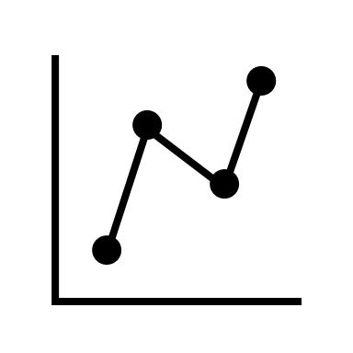

Developed Algorithm
Exploratory Analysis
Feature Selection
Model Development
Price Prediction
Model Accuracy
Initially, we performed different EDA analysis. Summary Statistics by Class, Density plot to see the distribution od data, histogram, Correlation matrix to find correlation among different features and pairs plot.
With our EDA, we have successfully analyzed different features of our data set based on Beans Class.
We have done ANOVA to find any significant features in our data set.
Next, we developed a 5 different classification algorithms using ‘CLASS’ as target variable.
We have split our data into 60 % training data and 40% test data and train our model.
Furthermore, we predicted and checked our results using test data.
With all of our built model, we predicted price for whole set of data of a definite farm and compared our results.
Lastly, we compared the results obtained from models and came to a conclusion.

Slide 7
Statistical distribution of features of dry bean varieties (in pixels).
The minimum, maximum, mean and standard deviation data of the features obtained for all dry bean samples are given in Table 1
Parameter | Mean | Standard Dev. | Median | Minimum | Maximum | Range
Area | 69875 | 49578.52 | 48714.5 | 20645 | 251320 | 230675
Perimeter | 1012.24 | 347.75 | 941.9 | 384.17 | 2164.1 | 1779.93
Major Axis Length | 362.05 | 124.52 | 332.9 | 161.52 | 740.97 | 579.45
Minor Axis Length | 225.19 | 73.35 | 202.73 | 106 | 473.39 | 367.39
Eccentricity | 0.76 | 0.1 | 0.77 | 0.3 | 0.94 | 0.64
ConvexArea | 70944.1 | 50382.27 | 50807.5 | 8912 | 259965 | 251053
Extent | 0.75 | 0.05 | 0.77 | 0.57 | 0.85 | 0.28
The variables, Area and Convex Area, had the largest range for all four datasets.
There are large differences in the range of variables, the variables with larger ranges can dominate over those with small ranges which may lead to biased results.
In these results, the mean area for the dry beans is 69,875, and the median area is 48,714.5. The data appear to be skewed to the right, which explains why the mean is greater than the median.
While Extent and Eccentricity appears to be skewed to the left as mean is less than the median.

Slide 8
Summary Statistics (Class COVARIANCE)
Class | Area | Perimeter | Maj.Axis. | Min.Axis. | Eccentricity | Convex Area | Extent
BOMBAY | 5.53E+08 | 32015.8 | 3177.899 | 826.684 | 0.547263 | 259965 | 0.850243
CALI | 91528410 | 26272.79 | 1188.178 | 491.4581 | 0.618366 | 117510 | 0.842753
DERMASON | 24651963 | 22913.81 | 696.7121 | 498.7684 | 0.549495 | 56174 | 0.847196
HOROZ | 56765885 | 24960.58 | 1252.489 | 456.5644 | 0.722737 | 82462 | 0.842089
SEKER | 22567179 | 24170.41 | 736.8507 | 419.4165 | 0.300635 | 65674 | 0.81831
SIRA | 22641401 | 23977.06 | 782.4715 | 401.8085 | 0.609884 | 73945 | 0.841802
From above table, we can have an idea about the class variances which measures variability from the average or mean.
The variance of each variable by class shows evidence of non-constant variance.

Slide 9
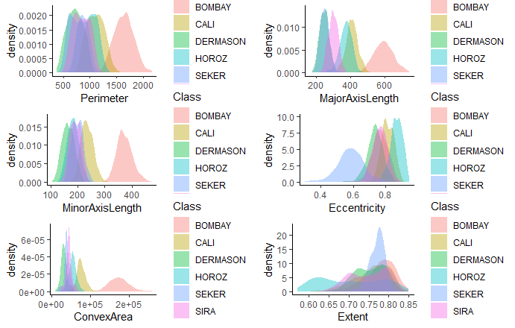
Exploratory Data Analysis (density plot)
Density plot represents distribution of a numeric variable using kernel density estimate to show the probability density function of the variable
For variable ‘Perimeter’ we can see bimodal distribution in data and class ‘BOMBAY’ is off from others.
For Eccentricity, class ‘SEKER’ is left skewed.
In the ‘Extent’ parameter, we can see bimodal distribution and class ‘HOROZ’ is right skewed.
For variables related to area, length and perimeter, class ‘BOMBAY’ has bell shaped distribution but not similar to other classes.

Slide 10
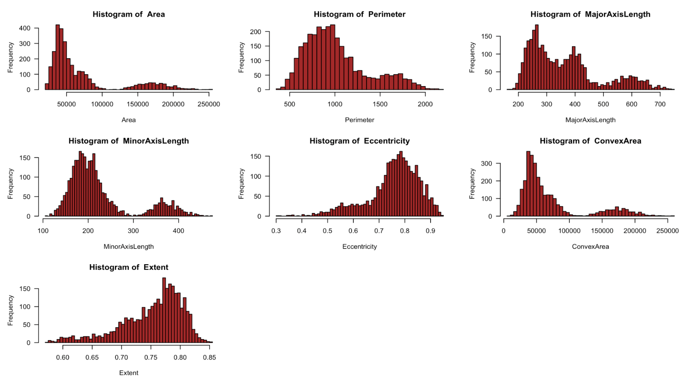
Exploratory Data Analysis (Histogram)
The histograms from the labeled data reveal that the variables exhibit multimodal behavior.
This indicates that at least one of the bean classes differs greatly from the others.
Further investigation revealed that the kind of BOMBAY beans is to blame for the multimodality.

Slide 11
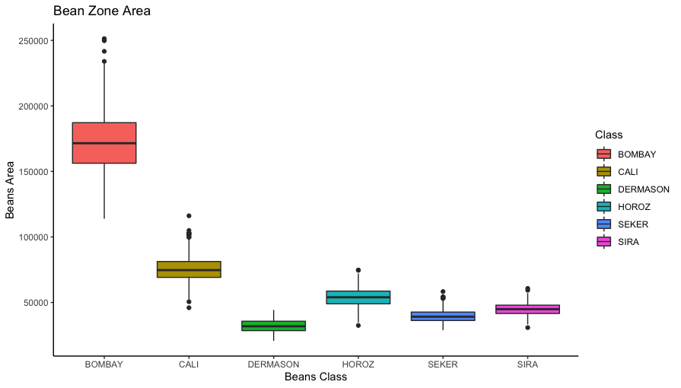
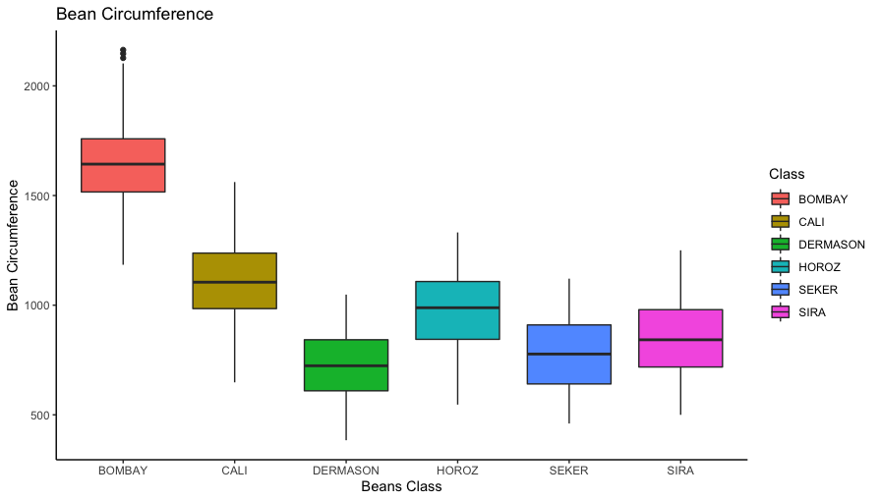
Exploratory Data Analysis (Boxplot)
A boxplot is a standardized way of displaying the distribution of data based on a five number summary (“minimum”, first quartile (Q1), median, third quartile (Q3), and “maximum”)
Plotted variables ‘Beans Area’ and ‘Perimeter’ with respect to each class.
For class ‘BOMBAY’, we can say that their range is highest.
All of the classes have similar variability except the ‘BOMBAY’.
These inference is justified when we built our model.
Median value of the class ‘DERMASON’ is lowest for both of the two parameters.
No skewness is observed except some outliers in the class ‘BOMBAY’

Slide 12
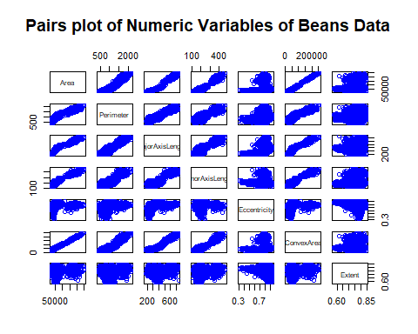
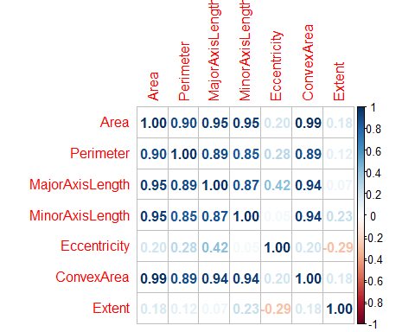
Feature Selection
Most of the variables except for Eccentricity and Extent are highly correlated with each other.
With using pairs plot, we can see Eccentricity and Extent are not having any correlation which is further validated with the correlation matrix on the right.

Slide 13
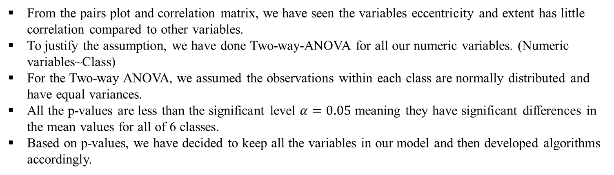
Analysis of variance
Parameter | Area | Perimeter | Major Axis Length | Minor Axis Length | Eccentrcity | ConvexArea | Extent
Sum Square | 6.87E+12 | 285666122 | 42590497 | 14591140 | 22.933 | 7.10E+12 | 1.707
Mean Square | 1.40E+12 | 57133224 | 8518099 | 2918228 | 4.587 | 1.42E+12 | 0.3414
F Statistic | 10877 | 2221 | 6523 | 5658 | 1715 | 8442 | 157.1
p-Value | 2.00E-16 | 2.00E-16 | 2.00E-16 | 2.00E-16 | 2.00E-16 | 2.00E-16 | 2.00E-16
From the pairs plot and correlation matrix, we have seen the variables eccentricity and extent has little correlation compared to other variables.
To justify the assumption, we have done Two-way-ANOVA for all our numeric variables. (Numeric variables~Class)
For the Two-way ANOVA, we assumed the observations within each class are normally distributed and have equal variances.
All the p-values are less than the significant level $α=0.05$ meaning they have significant differences in the mean values for all of 6 classes.
Based on p-values, we have decided to keep all the variables in our model and then developed algorithms accordingly.

Slide 14
STATISTICAL MODEL DEVELOPMENT
We have divided our data set into 60% training and 40% test data.
Using Linear Discriminant Analysis (LDA), Quadratic Discriminant Analysis (QDA), Mclust , and Mclust ‘EDDA’, we created confusion matrix for actual and predicted model and calculated accuracy.
From the actual and predicted class, we tried to compare the price of a particular farm having different types of beans.
LDA Model: A dimensionality reduction technique used to solve classification problems. Using the Linear combinations of predictors, LDA tries to predict the class of the given observations. [4]
QDA Model is the general form of Bayesian discrimination. Like LDA, the QDA classifier results from assuming that the observations from each class are drawn from a Gaussian distribution and plugging estimates for the parameters into Bayes’ theorem in order to perform prediction. [5]
Mclust and Mclust EDDA are powerful and popular packages which allows modelling of data as a Gaussian finite mixture with different covariance structures and different numbers of mixture components [3]
[3] https://www.ncbi.nlm.nih.gov/pmc/articles/PMC5096736/pdf/nihms793803.pdf
[4] https://www.geeksforgeeks.org/linear-discriminant-analysis-in-r-programming
[5] Gareth James, Daniela Witten, Trevor Hastie, Robert Tibshirani. (2013). An introduction to statistical learning : with applications in R. New York :Springer,

Slide 15
Linear Discriminant Analysis (LDA) Model
Confusion Matrix and Accuracy – Training Data
Actual | Predict
 | BOMBAY | CALI | DERMASON | HOROZ | SEKER | SIRA
BOMBAY | 300 | 0 | 0 | 0 | 0 | 0
CALI | 0 | 277 | 0 | 24 | 1 | 1
DERMASON | 0 | 0 | 233 | 3 | 22 | 47
HOROZ | 0 | 12 | 0 | 244 | 0 | 22
SEKER | 0 | 1 | 15 | 0 | 248 | 4
SIRA | 0 | 10 | 52 | 29 | 29 | 226
LDA Model Accuracy on Training Data: 84.88%
We have 1800 records in our training data set with 300 in each classes of beans. Our LDA model has an accuracy of 84.88% in terms of predicting beans classes.
Confusion Matrix and Accuracy – Test Data
Actual | Predict
 | BOMBAY | CALI | DERMASON | HOROZ | SEKER | SIRA
BOMBAY | 199 | 0 | 0 | 0 | 0 | 0
CALI | 1 | 184 | 0 | 9 | 1 | 3
DERMASON | 0 | 0 | 159 | 3 | 6 | 27
HOROZ | 0 | 8 | 1 | 171 | 0 | 14
SEKER | 0 | 0 | 4 | 0 | 181 | 1
SIRA | 0 | 8 | 36 | 17 | 12 | 155
LDA Model Accuracy on Test Data: 87.41%

Slide 16
Price Prediction Using LDA Model
 | Train Data |  | Test Data
Class | Actual no of Beans | Predicted Beans | Actual Beans | Predicted Beans
Bombay | 300 | 300 | 200 | 199
Cali | 303 | 303 | 200 | 198
Dermason | 305 | 305 | 200 | 195
Horoz | 278 | 278 | 200 | 194
Seker | 268 | 268 | 200 | 186
Sira | 346 | 346 | 200 | 228
From our training and test data, we have calculated actual and predicted number of beans per class using LDA Model.
These number are used further to calculate total actual and predicted price of beans.
For our convenience, we have converted each class of beans as factor : Bombay=1,Cali = 2 Dermanson = 3, Horoz=4, Seker =5, Sira = 6
 | Actual Weight (gm) | Actual Weight (lbs) | Actual Price ($) | Predicted Weight(gm) | Predicted Weight(lbs) | Predicted Price ($)
Train Data | 1260 | 2.77 | 12.93 | 1253.59 | 2.76 | 13.013
Test Data | 840 | 1.85 | 8.62 | 836.12 | 1.84 | 8.6431
From Our train Data, the actual price was $12.93, and the predicted price is $13.013
From our test data, actual price is $1.85, and predicted price is $8.643

Slide 17
Quadratic Discriminant Analysis (QDA) Model
Confusion Matrix and Accuracy – Training Data
Actual | Predict
 | BOMBAY | CALI | DERMASON | HOROZ | SEKER | SIRA
BOMBAY | 300 | 0 | 0 | 0 | 0 | 0
CALI | 0 | 290 | 0 | 12 | 0 | 2
DERMASON | 0 | 0 | 257 | 3 | 14 | 21
HOROZ | 0 | 9 | 0 | 268 | 0 | 20
SEKER | 0 | 1 | 14 | 0 | 266 | 14
SIRA | 0 | 0 | 29 | 17 | 20 | 243
QDA Model Accuracy on Training Data: 90.22%
We have 1800 records in our training data set with 300 in each classes of beans. Our QDA model has an accuracy of 90.22% in terms of predicting beans classes.
Confusion Matrix and Accuracy – Test Data
Actual | Predict
 | BOMBAY | CALI | DERMASON | HOROZ | SEKER | SIRA
BOMBAY | 200 | 1 | 0 | 0 | 0 | 0
CALI | 0 | 189 | 0 | 5 | 1 | 2
DERMASON | 0 | 0 | 173 | 3 | 0 | 20
HOROZ | 0 | 7 | 1 | 185 | 0 | 12
SEKER | 0 | 1 | 2 | 1 | 188 | 4
SIRA | 0 | 2 | 24 | 6 | 11 | 162
QDA Model Accuracy on Test Data: 91.41%

Slide 18
Price Prediction Using QDA Model
 | Train Data |  | Test Data
Class | Actual no of Beans | Predicted Beans | Actual Beans | Predicted Beans
Bombay | 300 | 300 | 200 | 201
Cali | 303 | 304 | 200 | 197
Dermason | 305 | 295 | 200 | 196
Horoz | 278 | 297 | 200 | 205
Seker | 268 | 295 | 200 | 196
Sira | 346 | 309 | 200 | 205
From our training and test data, we have calculated actual and predicted number of beans per class using QDA Model.
These number are used further to calculate total actual and predicted price of beans.
For our convenience, we have converted each class of beans as factor : Bombay=1,Cali = 2 Dermanson = 3, Horoz=4, Seker =5, Sira = 6
 | Actual Weight (gm) | Actual Weight (lbs) | Actual Price ($) | Predicted Weight(gm) | Predicted Weight(lbs) | Predicted Price ($)
Train Data | 1260 | 2.777 | 12.9304 | 1260.45 | 2.778 | 12.974
Test Data | 840 | 1.85 | 8.62 | 841.51 | 1.855 | 8.639
From Our train Data, the actual price was $12.93, and the predicted price is $12.97
From our test data, actual price is $1.85, and predicted price is $8.639

Slide 19
MCLUStDA Model
Confusion Matrix and Accuracy – Training Data
Actual | Predict
 | BOMBAY | CALI | DERMASON | HOROZ | SEKER | SIRA
BOMBAY | 300 | 0 | 0 | 0 | 0 | 0
CALI | 0 | 290 | 0 | 9 | 1 | 0
DERMASON | 0 | 0 | 257 | 0 | 14 | 29
HOROZ | 0 | 12 | 3 | 268 | 0 | 17
SEKER | 0 | 0 | 14 | 0 | 266 | 20
SIRA | 0 | 2 | 21 | 20 | 14 | 243
MclustDA Model Accuracy on Training Data: 91.41%
We have 1800 records in our training data set with 300 in each classes of beans. Our ‘MclustDA’ model has an accuracy of 91.41% in terms of predicting beans classes.
Confusion Matrix and Accuracy – Test Data
Actual | Predict
 | BOMBAY | CALI | DERMASON | HOROZ | SEKER | SIRA
BOMBAY | 200 | 0 | 0 | 0 | 0 | 0
CALI | 0 | 193 | 0 | 4 | 1 | 2
DERMASON | 0 | 0 | 172 | 1 | 3 | 24
HOROZ | 0 | 7 | 3 | 184 | 0 | 6
SEKER | 0 | 1 | 1 | 0 | 191 | 7
SIRA | 0 | 3 | 16 | 7 | 4 | 170
MclustDA Model Accuracy on Test Data: 92.5%

Slide 20
Price Prediction Using MclustDA Model
 | Train Data |  | Test Data
Class | Actual no of Beans | Predicted Beans | Actual Beans | Predicted Beans
Bombay | 300 | 300 | 200 | 200
Cali | 303 | 304 | 200 | 204
Dermason | 305 | 295 | 200 | 192
Horoz | 278 | 297 | 200 | 196
Seker | 268 | 295 | 200 | 199
Sira | 346 | 309 | 200 | 209
From our training and test data, we have calculated actual and predicted number of beans per class using MclustDA Model.
These number are used further to calculate total actual and predicted price of beans.
For our convenience, we have converted each class of beans as factor : Bombay=1,Cali = 2 Dermanson = 3, Horoz=4, Seker =5, Sira = 6
 | Actual Weight (gm) | Actual Weight (lbs) | Actual Price ($) | Predicted Weight(gm) | Predicted Weight(lbs) | Predicted Price ($)
Train Data | 1260 | 2.777 | 12.9304 | 1260.45 | 2.778 | 12.974
Test Data | 840 | 1.85 | 8.62 | 841.05 | 1.854 | 8.66
From Our train Data, the actual price was $12.93, and the predicted price is $12.97
From our test data, actual price is $1.85, and predicted price is $8.66

Slide 21
MCLUSt ‘EDDA’ Model
Confusion Matrix and Accuracy – Training Data
Actual | Predict
 | BOMBAY | CALI | DERMASON | HOROZ | SEKER | SIRA
BOMBAY | 300 | 0 | 0 | 0 | 0 | 0
CALI | 0 | 286 | 0 | 11 | 1 | 2
DERMASON | 0 | 0 | 249 | 0 | 15 | 36
HOROZ | 0 | 18 | 3 | 257 | 0 | 22
SEKER | 0 | 1 | 15 | 0 | 263 | 21
SIRA | 0 | 3 | 34 | 21 | 13 | 229
MclustEDDA Model Accuracy on Training Data: 89.58%
We have 1800 records in our training data set with 300 in each classes of beans. Our ‘MclustEDDA’ model has an accuracy of 89.58% in terms of predicting beans classes.
Confusion Matrix and Accuracy – Test Data
Actual | Predict
 | BOMBAY | CALI | DERMASON | HOROZ | SEKER | SIRA
BOMBAY | 200 | 0 | 0 | 0 | 0 | 0
CALI | 0 | 188 | 0 | 7 | 1 | 4
DERMASON | 0 | 0 | 163 | 1 | 5 | 31
HOROZ | 0 | 8 | 3 | 177 | 0 | 12
SEKER | 0 | 1 | 1 | 0 | 188 | 10
SIRA | 0 | 4 | 25 | 9 | 5 | 157
MclustEDDA Model Accuracy on Test Data: 89.41%

Slide 22
Price Prediction Using MclustEDDA Model
 | Train Data |  | Test Data
Class | Actual no of Beans | Predicted Beans | Actual Beans | Predicted Beans
Bombay | 300 | 300 | 200 | 200
Cali | 303 | 304 | 200 | 204
Dermason | 305 | 295 | 200 | 192
Horoz | 278 | 297 | 200 | 196
Seker | 268 | 295 | 200 | 199
Sira | 346 | 309 | 200 | 209
From our training and test data, we have calculated actual and predicted number of beans per class using MclustDA Model.
These number are used further to calculate total actual and predicted price of beans.
For our convenience, we have converted each class of beans as factor : Bombay=1,Cali = 2 Dermanson = 3, Horoz=4, Seker =5, Sira = 6
 | Actual Weight (gm) | Actual Weight (lbs) | Actual Price ($) | Predicted Weight(gm) | Predicted Weight(lbs) | Predicted Price ($)
Train Data | 1260 | 2.777 | 12.9304 | 1260.45 | 2.778 | 12.974
Test Data | 840 | 1.85 | 8.62 | 841.05 | 1.854 | 8.66
From Our train Data, the actual price was $12.93, and the predicted price is $12.97
From our test data, actual price is $1.85, and predicted price is $8.66

Slide 23
Model Comparisons
 |  |  | Training Data |  | Test Data
Model | Train Accuracy (%) | Test Accuracy (%) | Actual Price ($) | Predicted Price ($) | Actual Price ($) | Predicted price ($)
LDA | 84.88 | 87.41 | 12.93 | 13.013 | 8.62 | 8.643
QDA | 90.22 | 91.41 | 12.93 | 12.974 | 8.62 | 8.639
Mclust DA | 91.41 | 92.5 | 12.93 | 12.97 | 8.62 | 8.66
Mclust EDDA | 89.58 | 89.41 | 12.93 | 12.97 | 8.62 | 8.66
We have developed four kinds of classification algorithms and predicted the price of beans.
Compared to all models, Mclust DA performed better with a test accuracy of 92.5% and the actual and predicted price on test data are very close.
We have also obtained similar results using QDA approach.

Slide 24
Conclusion
Initially, we have done EDA to see the distribution of data using Histograms and boxplots, our descriptive statistics helped to understand the variability and ranges.
Using two-way-ANOVA, we have done the feature selection criterion.
Based on our data, we have built four different classification algorithms (60% Train and 40% Test Data)and compared the accuracy of each models.
Accuracy: MclustDA >QDA> MclustEDDA>LDA
Finally, we have compared the predicted price for all the four models and found that QDA can most accurately predict price base on test data set.

Slide 25
References
Mazhar, K. A. R. A., et al. "Seed size and shape analysis of registered common bean (Phaseolus vulgaris L.) cultivars in Turkey using digital photography." Journal of Agricultural Sciences 19.3 (2013): 219-234.
Koklu, Murat, and Ilker Ali Ozkan. "Multiclass classification of dry beans using computer vision and machine learning techniques." Computers and Electronics in Agriculture 174 (2020): 105507.
James, Gareth, et al. An introduction to statistical learning. Vol. 112. New York: springer, 2013.
4. Lecture Notes and Materials From Stat 601 and Stat 602
Internet Resources
1. http://www.sthda.com/english/wiki/one-way-anova-test-in-r
2. https://www.guru99.com/r-anova-tutorial.html
3. https://gexijin.github.io/learnR/importing-data-and-managing-files.html
4. https://agroninfotech.blogspot.com/2021/11/rapid-publication-ready-anova-table-in-r.html
5. https://gexijin.github.io/learnR/index.html
6. https://stats.oarc.ucla.edu/r/dae/multinomial-logistic-regression/
7. https://rpubs.com/lmorgan95/ISLR_CH4_Solutions
8. https://rpubs.com/zlzlzl2/754880
9. https://rpubs.com/Richie222/853114
10. https://pages.cms.hu-berlin.de/EOL/gcg_quantitative-methods/Lab11_LDA_Model-assessment.html#Linear_Discriminant_Analysis
11. MCLust : https://www.ncbi.nlm.nih.gov/pmc/articles/PMC5096736/pdf/nihms793803.pdf
12. LDA: http://rstudio-pubs-static.s3.amazonaws.com/35817_2552e05f1d4e4db8ba87b334101a43da.html
13. https://stats.oarc.ucla.edu/r/dae/multinomial-logistic-regression/
14. https://sites.stat.washington.edu/mclust/
15. https://bradleyboehmke.github.io/HOML/model-clustering.html
16. Textbook: An Introduction to Statistical Learning With Appliaction in R by Gareth James, Daniela Witten, Trevor Hastie and Robert Tibshirani
17. STAT 602 and 601 Lecture Slides and Videos
18. https://alessiopassalacqua.github.io/getstrongeR-Rstats/readings.html
19. https://beta.rstudioconnect.com/content/2025/dplyr.nb.html
20. https://alessiopassalacqua.github.io/getstrongeR-Rstats/readings.html
21. https://www.webpages.uidaho.edu/~stevel/519/literatures/MCLUST%20for%20R.pdf
22. https://bradleyboehmke.github.io/HOML/model-clustering.html

